Slide 1


EmoSense AI
AI Based Emotion Recognition from Text
Presented By:
Bakshish Kaur (22)

Slide 2




Problem Statement
Standard sentiment analysis classifies text as merely Positive, Negative, or Neutral. This fails to capture the complexity of human interaction.
Emotional nuances like Grief vs. Sadness or Anger vs. Annoyance are lost.
Businesses cannot react appropriately to specific customer feelings.
Text-based AI often lacks the "EQ" needed for empathetic response.

Slide 3






Project Vision
Advanced EQ
GoEmotions
Efficiency
Moving beyond basic polarity to identify 28 unique emotional states using Deep Learning.
Leveraging Google's massive dataset of 58k Reddit comments labeled for granular emotions.
Utilizing DistilBERT for high-performance classification with a smaller, faster footprint.

Slide 4


Technical Ecosystem
Core Frameworks
Transformers: For BERT model access.
PyTorch: The backend engine for training.
Pandas/NumPy: Essential data manipulation.
Scikit-learn: For robust metrics evaluation.

Slide 5
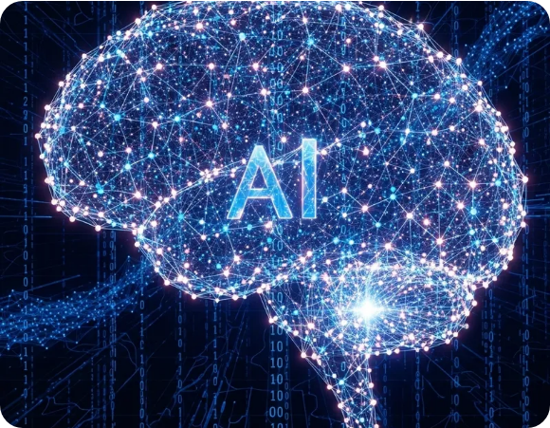
GoEmotions: The Foundation
Dataset Distribution
The simplified version of the GoEmotions dataset provides a high-quality slice of human sentiment:
Split | Count
Training Set | 43,410 rows
Validation Set | 5,426 rows
Test Set | 5,427 rows
*Models trained on 28 total emotion labels including 'Neutral'.

Slide 6
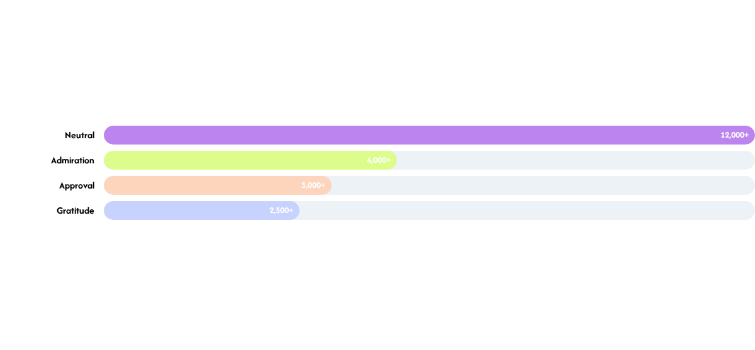
Exploratory Data Analysis
Top Emotion Prevalence (Train Set)
Analysis reveals a "Long Tail" distribution where common emotions are frequent, while others like 'Grief' and 'Pride' are sparse, presenting a training challenge.

Slide 7
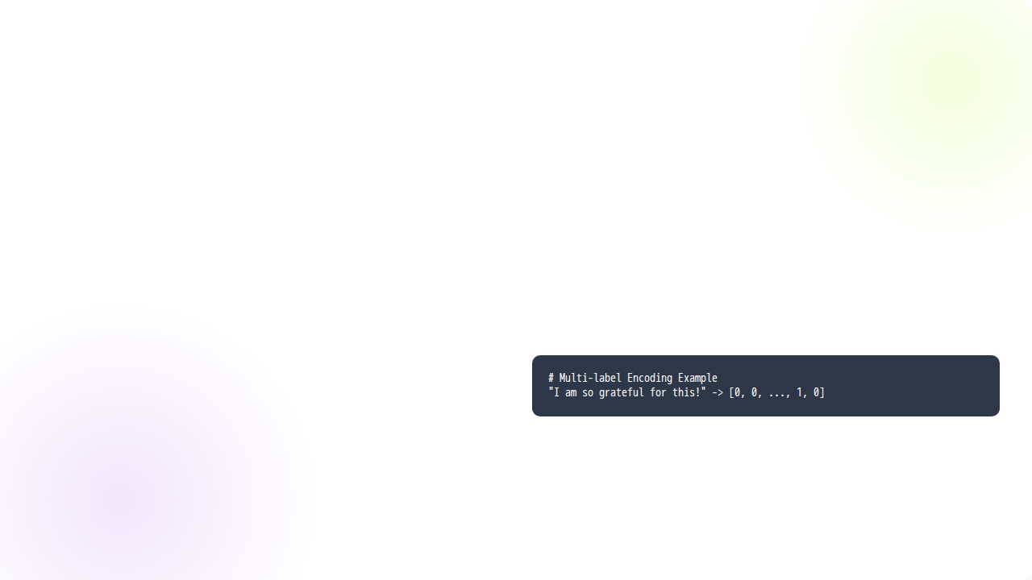

Data Preprocessing
Tokenization Strategy
The raw text is transformed into a fixed-size tensor representation. We convert nested emotion labels into a multi-label vector format where 1.0 represents the presence of an emotion and 0.0 its absence.
Model: DistilBertTokenizerFast
Truncation: Enabled
Max Length: 64 Tokens
Labels: Multi-hot encoding (float32)

Slide 8
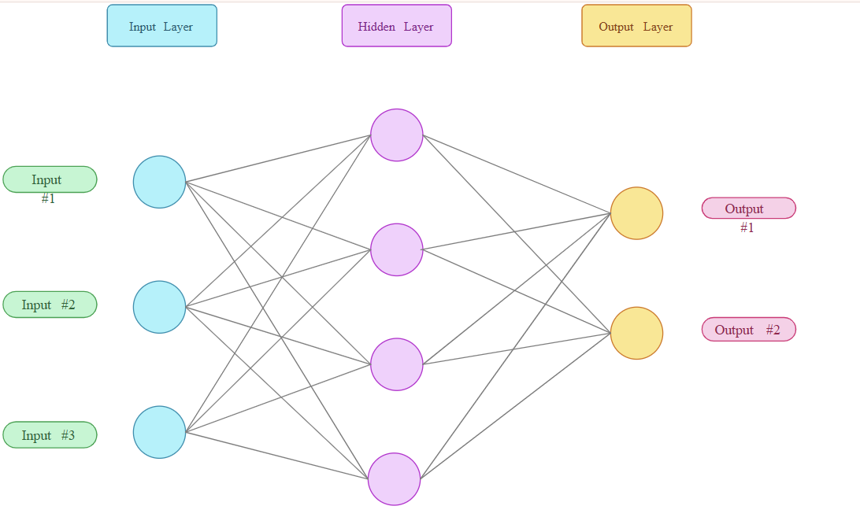
The "Brain": DistilBERT
DistilBertForSequenceClassification
Why DistilBERT?
•
Performance: Retains 97% of BERT's performance.
•
Speed: 60% faster inference and training.
•
Parameters: ~67 Million trainable parameters fine-tuned for Emo Sense.
The model uses a Multi-label Classification problem type, outputting probabilities for all 28 classes simultaneously.

Slide 9


Training Strategy
Hyperparameters
Loss & Metrics
•
Learning Rate: 2e-5
•
Loss: Binary Cross Entropy
•
Batch Size: 16
•
Optimization: AdamW
•
Epochs: 3
•
Metric: Macro F1-Score
•
Weight Decay: 0.01
•
Threshold: 0.3

Slide 10

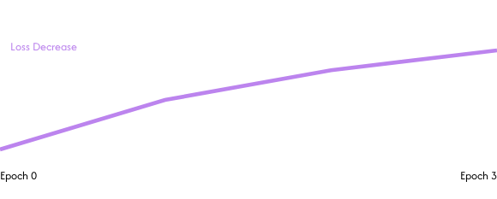
Learning Trajectory
Observations
Training loss decreased from ~0.139 to ~0.100 across 3 epochs. Validation loss followed closely, indicating a healthy fit without significant variance issues.
Macro F1 reached a peak of 0.2490 as the model learned to distinguish minority classes.

Slide 11
Model Performance
Validation Metrics Summary
Metric | Value
Evaluation Loss | 0.1045
Macro F1 Score | 0.2490
Samples Avg F1 | 0.4900
Precision (Weighted) | 0.5100
The model demonstrates high confidence in common emotions while maintaining predictive power across the multi-label spectrum.

Slide 12


Granular Performance
High Performers
Low Performers
•
Gratitude: 0.91 F1
•
Grief: 0.00 F1 (Sparse Data)
•
Remorse: 0.72 F1
•
Confusion: 0.00 F1
•
Amusement: 0.77 F1
•
Annoyance: 0.11 F1 (Ambiguous)
•
Admiration: 0.70 F1
•
Realization: 0.00 F1
Success is highly correlated with label frequency and linguistic distinctness (e.g., Gratitude uses specific keywords like 'thank').

Slide 13
Key Strength: Gratitude
Precision in Appreciation
92%
The model achieves an exceptional 92% precision for "Gratitude." This highlights the system's ability to be deployed in automated customer appreciation workflows or social monitoring with high reliability.

Slide 14

Inference in Action
"I just got promoted! This is the best day of my life!"
"I feel a bit nervous about the presentation tomorrow."
PREDICTION: Admiration (77.37%)
PREDICTION: Nervousness / Concern
The model effectively translates complex semantics into structured confidence scores.

Slide 15

Questions?
Thank you for your attention!
Presented by: Bakshish Kaur
AI-Based Emotion Recognition Project

